Slide 1

Non-Invasive point of care ECG signal detection and analytics for cardiac diseases
Bachelor of Technology
for the course
CL 498 Project II
Presented By
Shubham Kumar Gupta
Roll No. 180107058
Under supervision of
Assistant Professor Resmi Suresh
Professor Dipankar Bandyopadhyay

Slide 2
Content
Objective
Recap of Phase I
Electrically conductive surface
Black Box
Circuit Diagram
Requirements
Designed Prototype
Data Collection
Timeline
References

Slide 3
Objective
Development of our portable, noninvasive point-of-care system for monitoring ECG
Addition of a micro pattern electrode like Liquid Silicone Rubber Electrode.
Collection of our own datasets.
Implement our modelled data

Slide 4
Recap of Phase I
ECG records electrical signals in heart. It’s a common and painless test to quickly detect heart problems.
We studied the working principal of ECG, and seen various devices available to detect ECG levels.
Basic Analysis over Electrically conductive Surface
Studied Pros and Cons of Sanket’s 12 Lead ECG
We refined the available dataset.
We studied and developed our CNN model and tested this model on ECG single lead dataset detecting normal and abnormal ECG’s over the dataset available online.
We analyzed the accuracy and loss evaluated using the dataset.
Addition of a micro pattern electrode like Liquid Silicone Rubber Electrode.

Slide 5
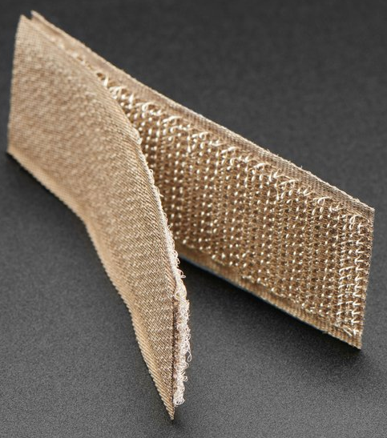

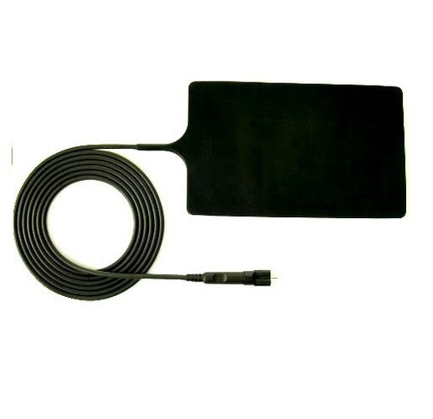



Electrically Conductive Surface
Electrode Materials |  | Components | Structure | Fabric Thickness (mm) | Yarn Diameter (mm) | Wales/cm | Courses/cm
TE1 |  | 78% silver plated nylon 66 + 22% Elastomer | Weft knitted | 0.45 ± 10% | 0.13 ± 20% | 28/cm | 30/cm
TE2 |  | 100% silver plated nylon 66 | Weft knitted | 1.25 ± 10% | 0.60 ± 20% | 5/cm | 6/cm
TE3 |  | 100% silver plated nylon 66 | Weft knitted | 0.70 ± 10% | 0.30 ± 20% | 8/cm | 12/cm
TE4 |  | 94% silver plated nylon 66 + 6% elastomer | Weft knitted 3D spacer | 2.50 ± 10% | 0.18 ± 20% | 17/cm | 28/cm
 |  |  |  |  |  | (surface) | (surface)
Conductive Hook & Loop
Resistivity: 1.4 Ohm per sq inch
Electrically conductive Silicone Rubber Sheet
Resistivity: 1.57 to 3.14 Ohm per sq inch
Avg : 2.35 Ohm per sq inch
A Hybrid Textile Electrode for Electrocardiogram (ECG) Measurement and Motion Tracking (nih.gov)
Conductive Hook & Loop Tape - 3" long - Thingbits Electronics
Electrically Conductive Silicone Rubber Sheet, Thickness: 1.6 to 3.2 mm, Rs 125 /meter | ID: 16623200873 (indiamart.com)

Slide 6
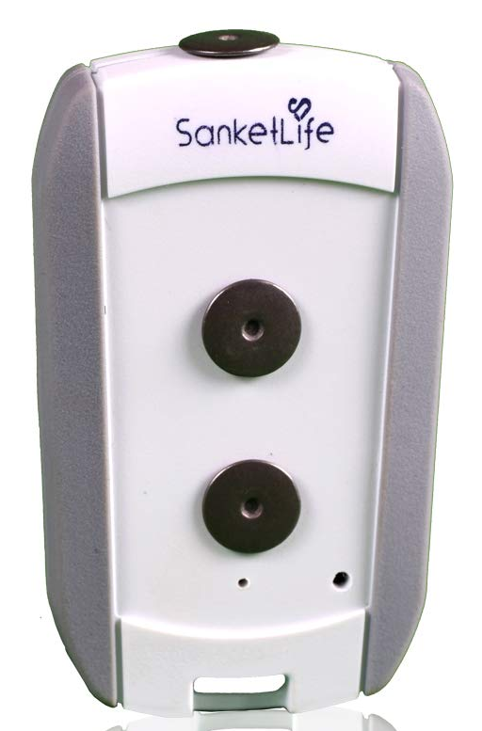
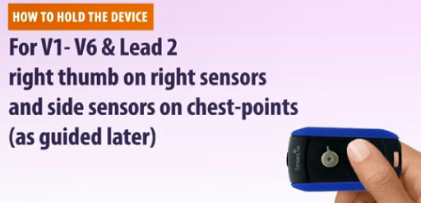
Black Box
Pros
Sanket's ECG is small portable ECG device that is widely used in rural markets.
Cheap and no need for additional wired electrode placements.
Can record 12 Lead ECG signal
Has total of 2 electrode contact point system, which are touched at different body parts to get a single lead ECG
Completing different circuits we can get all 12 Leads ECG using it
Cons
Needs assistance of a medical practitioner to use it
Misplacement of electrode may result in improper results
Better noise deduction can be obtained
Sanket’s 12Lead ECG
Source:sanketlife.in

Slide 7
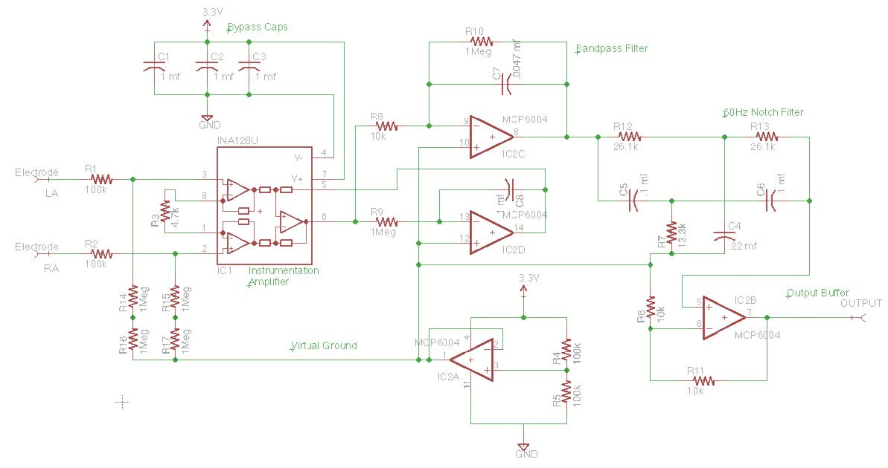
Black Box
Total of 2 electrode system
When touched at different body parts using electrodes circuit completes and single lead ECG is recorded
Completing different circuits we can get all 12 Leads ECG using it
Circuit contains electrodes, a bypass capacitor (removes DC noise), amplifier (to amplify lower signals), bandpass filter circuit and a notch filter to remove noise and tune the ECG recording
Circuit Diagram
Source: CSE 474 courses.cs.washington.edu

Slide 8
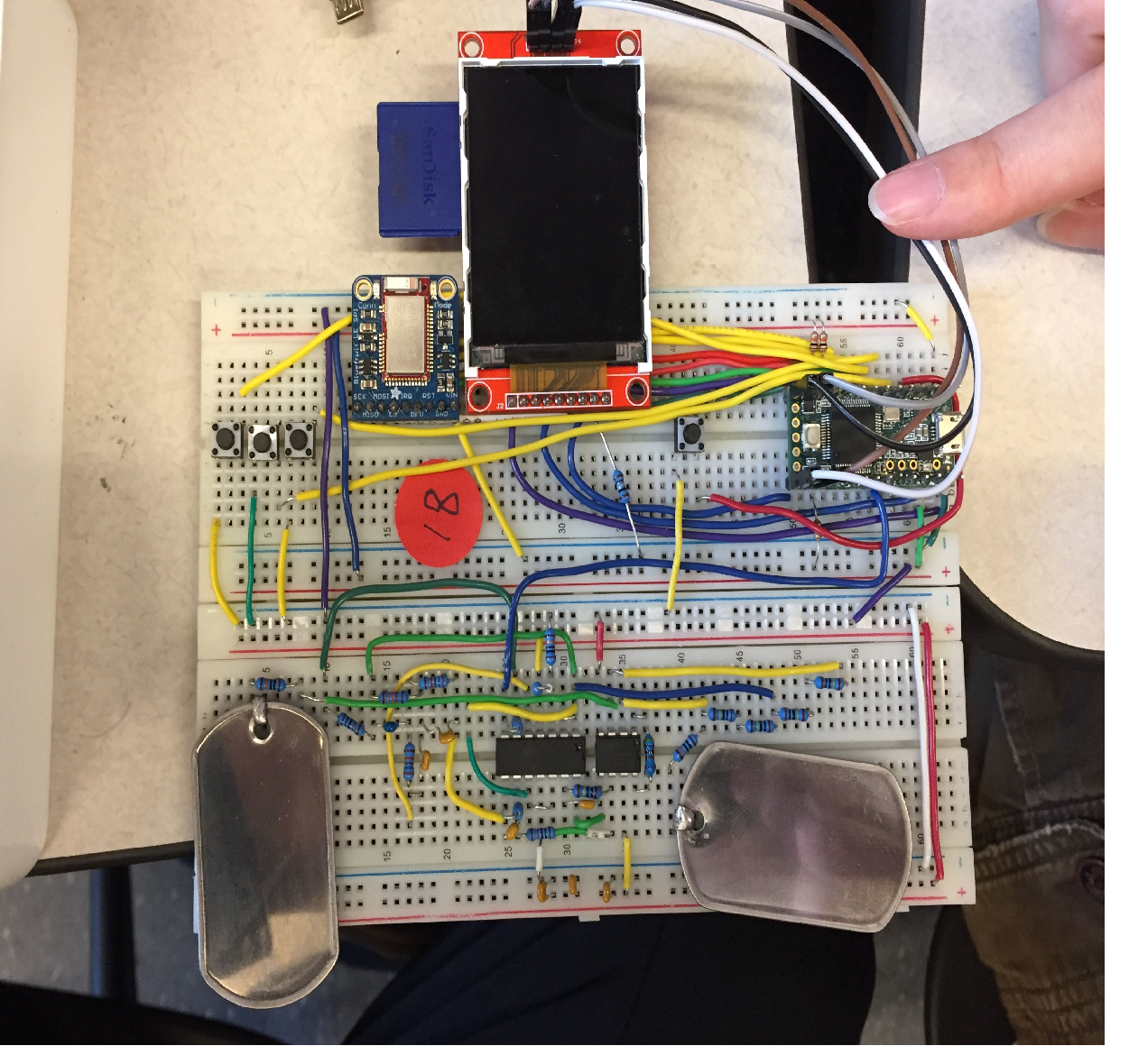
Black Box
Circuit Diagram
Source: CSE 474 courses.cs.washington.edu

Slide 9
Black Box
1 INA128 IC1 ✅ 570
1 MCP6004 IC2 ✅ 52
4 Res,100K R1,R2,R4,R5 ✅ 12
1 Res,4.7K R3 ✅ 12
3 Res,10K R6,R8,R11 ✅ 12
1 Res,13.3K R7 ✅110
6 Res,1meg R9,R10,R14,R15,R16,R17 ✅ 4
2 Res,26.1K R12,R13 ✅88
6 Cap,0.1mf C1,C2,C3,C5,C6,C8 ✅ 6
1 Cap,0.22mf C4 ✅ 5
1 Cap, 0.0047mf C7 ✅5
1 Perf Board (new) ✅ already have
2 Dog Tags, electrodes ✅ 400 (Amz)
Adafruit Bluefruit LE ✅ 3249 (Amz)
TFT LCD ✅ 659
Conductive Hook & Loop Tape or Electrically Conductive Silicone Rubber ✅600
32 GB SDCARD ✅ 900
Teensy 3.2 ✅1749 = 8,985 + 2,500 Sanket ECG
TOTAL 11,485

Slide 10
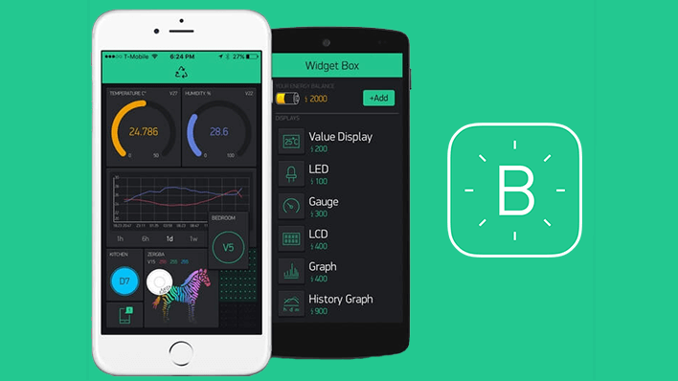
Black Box (Prototype)
MODEL PROTOTYPE

Slide 11
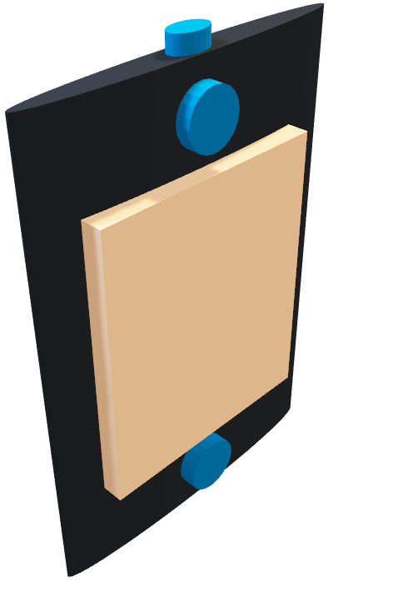
Black Box (Prototype)
MODEL PROTOTYPE

Slide 12
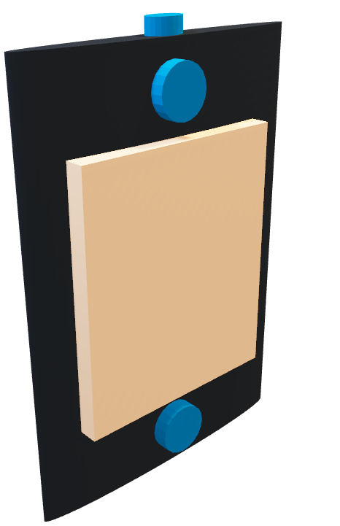
Black Box (Prototype)
MODEL PROTOTYPE

Slide 13
Data Collection
Data Collection at different time frames like at Morning, Afternoon, Evening, at Night, etc.
Data Collection at different motions like after running, and relaxed moment, and while sleeping, walking, etc.
Will collect first data from myself.
Same repetition, I will be following with my family and in my neighborhood
Will try to collect almost 500+ data, only 1 Lead ECG data.

Slide 14
Timeline
Results till 27th Feb 2022 (1 Lead)
Device Buy
Results After 1 week 10th March 2022 (1 Lead)
Devices Setup 1 Lead
First ECG
Data collection
Code Hardware
Results After 25th March 2022 (1 Lead)
Blynk Application Setup
Local Server/GCP API Creation
ML output live analysis

Slide 15
References
https://courses.cs.washington.edu/courses/cse474/17wi/labs/l6/l6.html
A Hybrid Textile Electrode for Electrocardiogram (ECG) Measurement and Motion Tracking (nih.gov)
Conductive Hook & Loop Tape - 3" long - Thingbits Electronics
Electrically Conductive Silicone Rubber Sheet, Thickness: 1.6 to 3.2 mm, Rs 125 /meter | ID: 16623200873 (indiamart.com)
How to make a hook and loop soft switch - Kitronik University – YouTube
Log High Speed ECG or Other Data, Continuously for Over a Month : 6 Steps – Instructables
gaodingpan/ECG-on-Teensy (github.com)

